Slide 1

International Trade Issues, Part 2
Amanda Hodges, Ph.D.
Entomology/Nematology Dept.
University of Florida
Exotic Species & Biosecurity Issues ALS 4161/6166

Slide 2
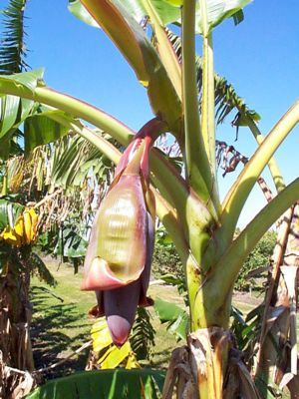
2009-10 EU-ACP Banana Issues
2009 Geneva Agreement on Trade in Bananas
Should MFN (Most Favored Nation) clause be allowed?
Source: http://brussels.cta.int/index.php?option=com_k2&id=4699&view=item&Itemid=

Slide 3
Concept Excerpts and Discussion
Brasier, C.M. 2008. The biosecurity threat to the UK and global environment from international trade in plants.

Slide 4
Brasier (2008)
What is the paper’s purpose?
Is it a scientific article or opinion-based?

Slide 5
Pathogen and Pest Movement
“Movement of plants and plant products between biogeographical zones by human activities is now generally accepted to be the primary mode of introduction for exotic pathogens and pests.”
Most of the Brasier (2008) articles focuses on plant pathogens.
What about other pathways?

Slide 6
Brasier’s Biosecurity Definition
Biosecurity: “protecting a state from invasive plant pathogens is often referred to as plant biosecurity.”

Slide 7
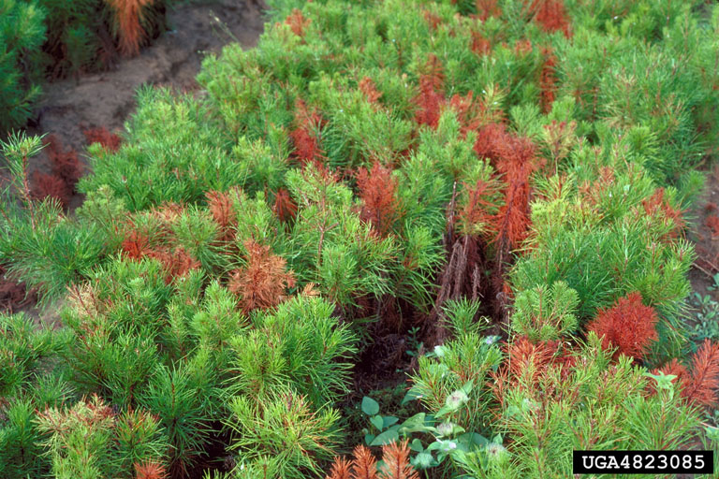
Invasive Plant Pathogens
Littleleaf Disease, Phytophthora cinnamoni
Origin: Southeast Asia
Spreading worldwide for 150 years
Currently threatening plant communities throughout Australia
Photo Credit: Edward Barnard, FDACS,
Division of Forestry, http://www.invasive.org/
Image: 4823085

Slide 8
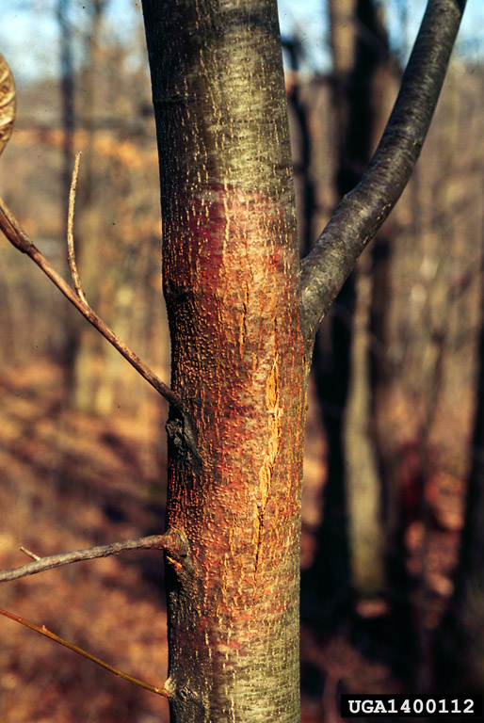
Invasive Plant Pathogens
Chestnut blight, Cryphonectria parasitica
Origin: China and Japan
American chestnut forests destroyed within 30 years following ~1910 introduction.
Photo Credit: Linda Haugen, USDA Forest Service
http://www.invasives.org/ Image 1400112

Slide 9
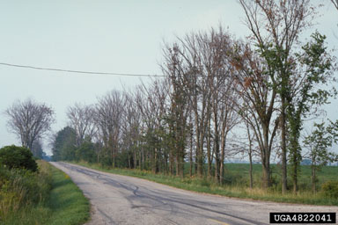
Dutch Elm Disease
Dutch Elm’s Disease
Arrived in North American in 1917 on diseased logs.
Photo Credit: Edward Barnard, FDACS
Division of Forestry, http://www.invasives.org/
Image No. 4822041

Slide 10
New Pathogens to the UK
1970-2004: 234 new plant pathogens.
67% of these new plant pathogens were with ornamental plants.
“Many ‘newly escaped’ organisms were previously unknown to science”
Unknown organisms are not on international lists of pests of concern.
Only 7-10% of fungal pathogens have been identified.
Notes:
The genus Phytophthora, considered by many to be the world’s most destructive group of plant pathogens, may be between 100 and 500.

Slide 11
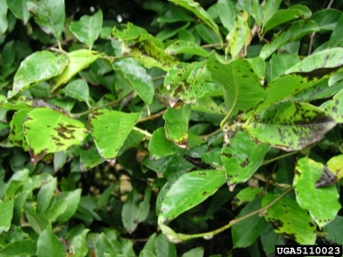
Invasive Plant Pathogens
Phytophthora kernoviae
Origin: Asia
1990’s-Europe
Beech, Rhododendrum, Magnolia
Photo Credit: Forest Research, United
Kingdom Forestry Research, UK
http://www.invasives.org/ Image: 5110023

Slide 12
New Pathogen Detections
Why so many undetected pathogens?
Example-third species of Dutch elm disease fungus detected in the Himalayas
Notes:
Darwinian evolution predicts that, being adapted to and co-evolved with their hosts, many of these pathogens are unlikely to do noticeable damage to their native ecosystems. This new species of Dutch elm disease fungus is highly aggressive to European elms, but fairly benign for its native range in the Himalyans.

Slide 13
Pest Risk Assessments (PRA)
Reactive, developed after a threat has become apparent.
The risk of a pathogen’s ability to co-evolve is not considered.
Limited resources have resulted in PRAs not occurring, even for organisms identified as a threat.
Should genotypes be considered?
Notes:
We are increasingly understanding the complex breeding structure of pathogens, and in some cases, introduction of a new genotype could result in an unwanted epidemic.

Slide 14
Trade Problems
Non-Compliant Members may Ship Pathogen Problems to those under Compliance.
Visual inspection not adequate to indicate that a plant is disease-free.
Increase trade in rootstock-based plants increases risk of spread.
Few incentives for adhering to protocols.

Slide 15
Brasier (2008) Discussion
Suggests that risk could be reduced by “limiting the level of plant imports to the minimum necessary for subsequent propagation.”
More transparency, education, and information for the general public, similar to outbreaks of FMD, blue tongue, and avian flu.

